Slide 1
Inference Servers
New Technology | Same old security flaws

Slide 2
About Me
Principal Security Consultant at Kroll
  Mostly doing AppSec tests
Not a math/data science/AI PHD
  Not exactly an AI advocate.
  I’m just here for the zipline code execution vulnerabilities

Slide 3
Outline
Introduction to ML Models
  Using a Model
  PyTorch Pickles and other file formats
Inference Servers
  TorchServe
  TorchServe Security Concerns
  Other Inference Servers

Slide 4
Intro to ML Models
Now with 100% less math

Slide 5


What is a model?
Models are created using a library like PyTorch
Models are trained using patterns of previously analyzed data.
Models return a prediction based on the input sent to them.
  This is called inference!

Slide 6
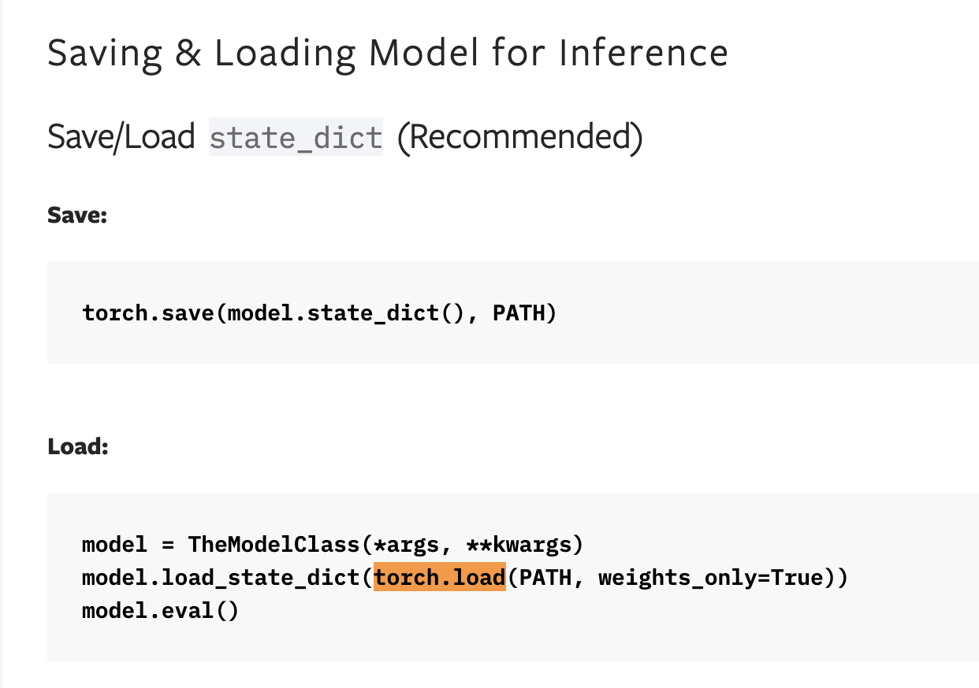
Models are files
  Once a model has been trained, it is exported to a file.
  Models exist on the filesystem.
  Models are loaded using the same library that created them.
  Conceptually, running a model is like executing a binary.

Slide 7
Models can be a security headache
Models can come in dangerous file formats.
Models have supporting files (handlers)
Models are easy to share
  Anyone can download models online
  Models are commonly shared within Python Notebooks

Slide 8
Using a Model
It is surprisingly (worryingly) easy!

Slide 9
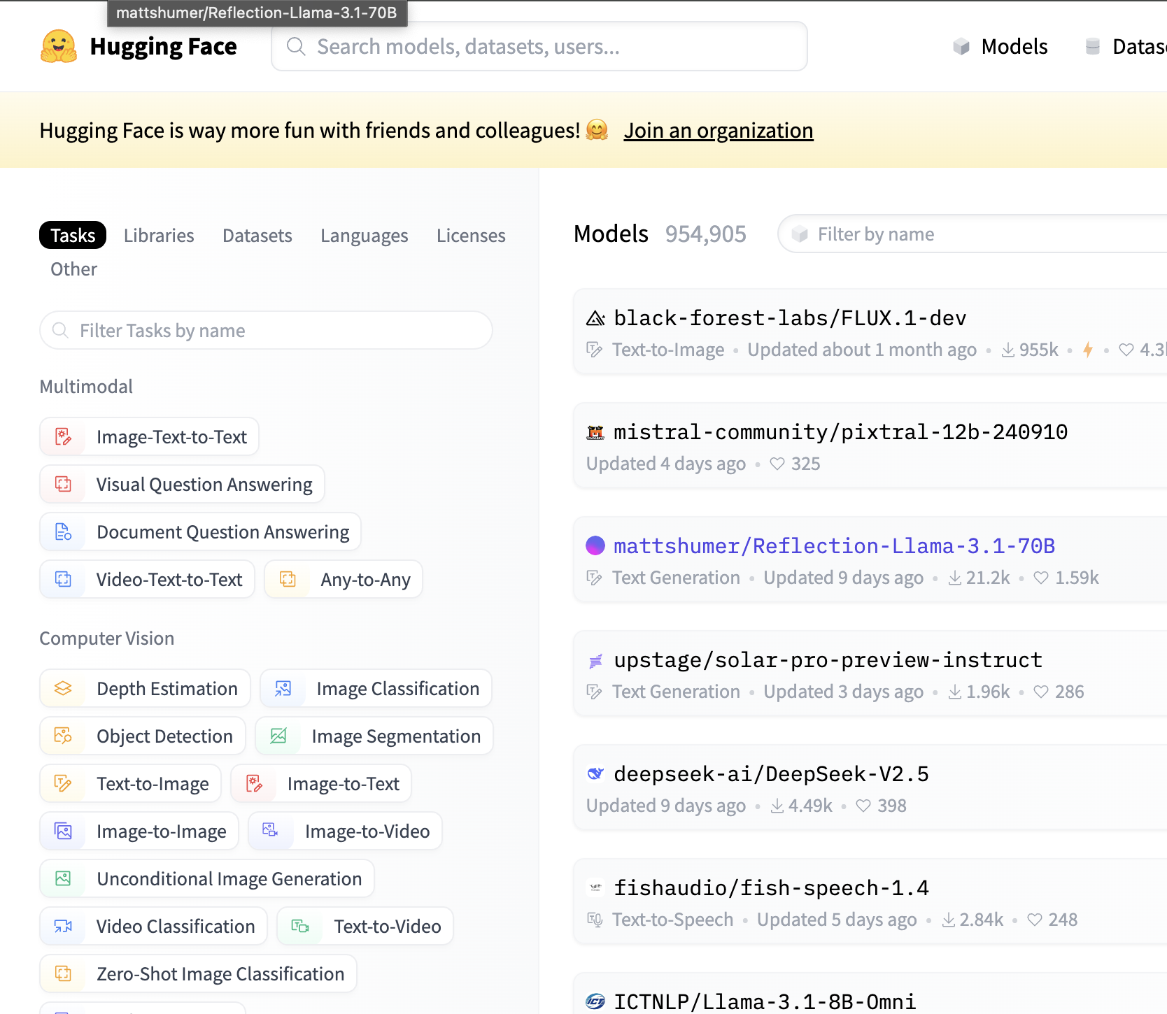
HuggingFace
GitHub for models.
  Many different options, including LLMs.
  Support for multiple platforms.
transformers library
  Provides various auto-magic functions
  Use a configured backend (e.g PyTorch)

Slide 10
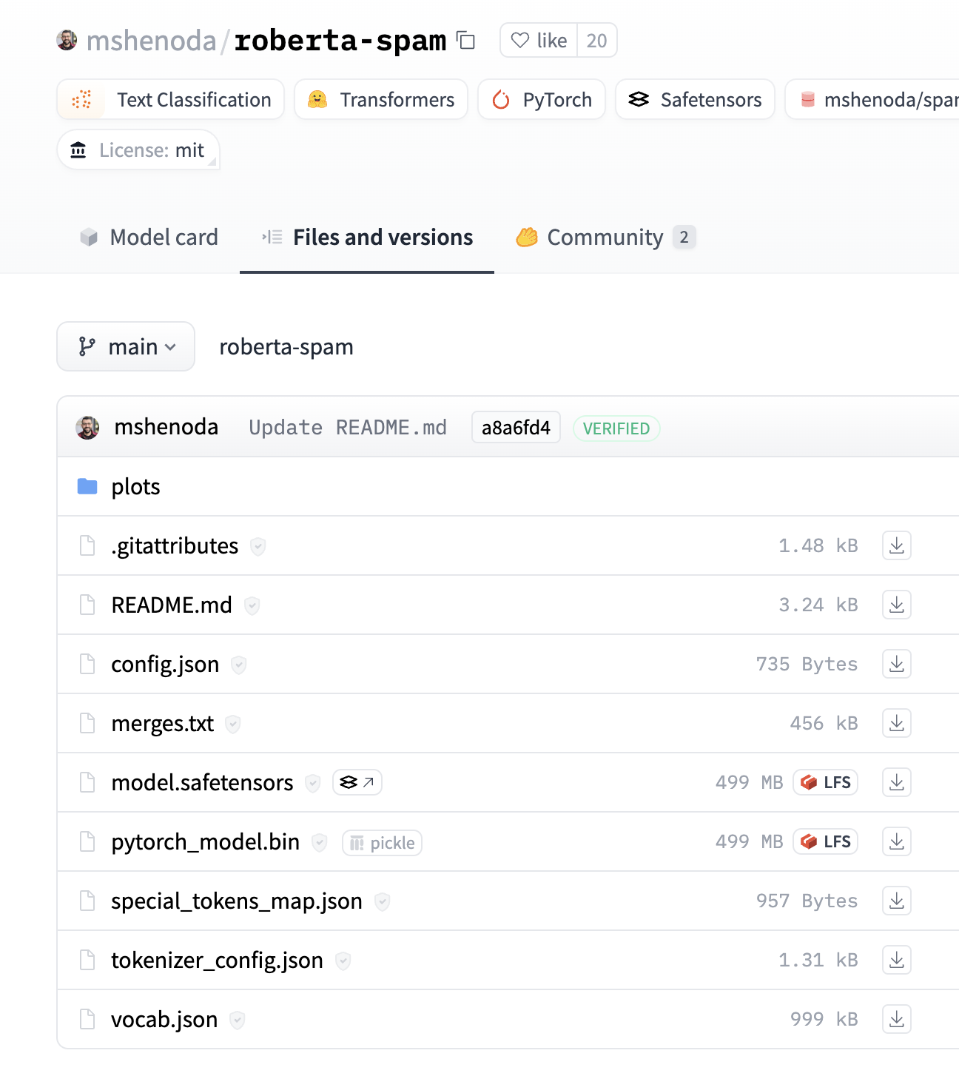
Roberta Spam
  Accepts tokenized text as input.
  Evaluates text to determine if its spam.
  Returns two output values
    (0 [ham], 1 [spam])

Slide 11
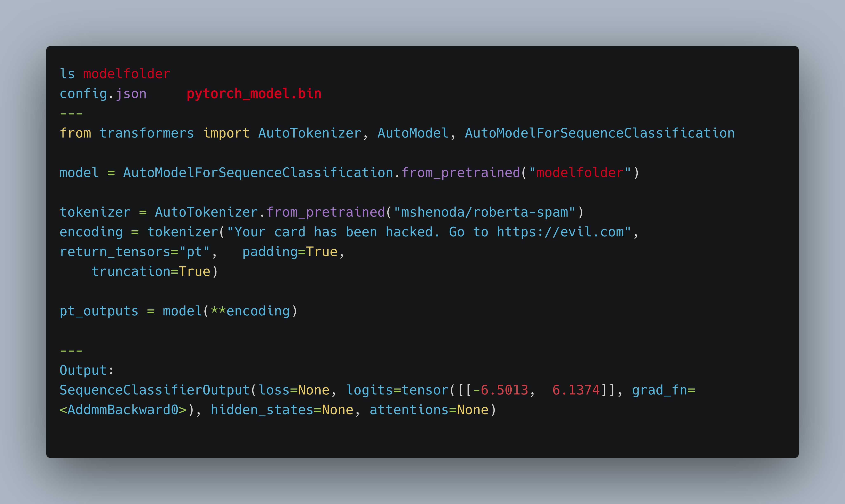

Slide 12
PyTorch Pickles
And other dangerous file formats

Slide 13
PyTorch Models Are Pickles
PyTorch models are pickle files
  When saved, and loaded models are serialized python pickles.
User input into torch.load() will lead to code execution
  * unless the new weights_only flag is set.

Slide 14
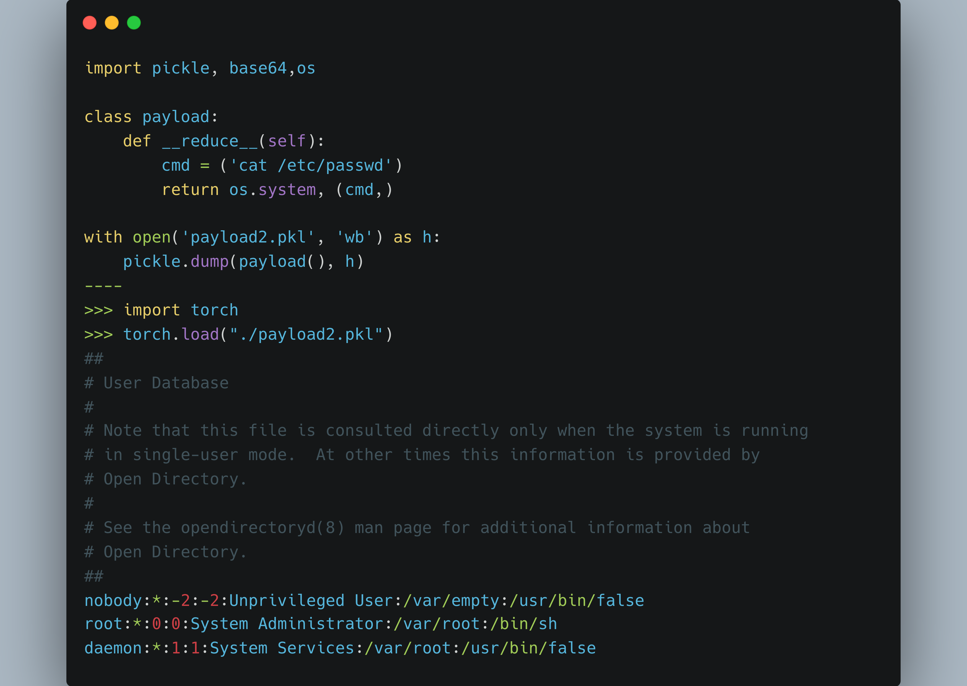
Python Pickles – Basic Example

Slide 15
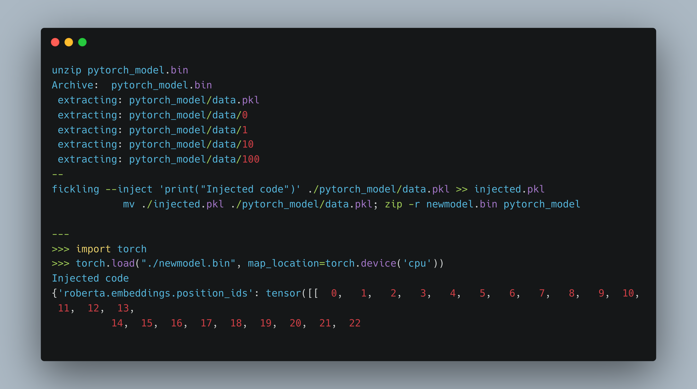
PyTorch Pickles – Model Injection

Slide 16
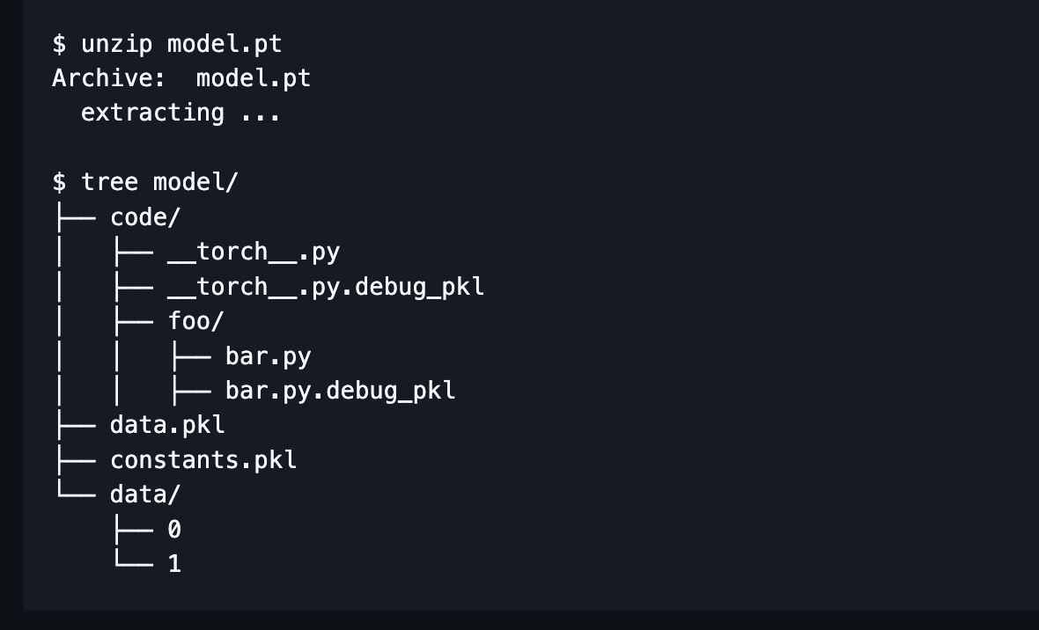
Other Model Formats - TorchScript
  Optimized PyTorch Models
  Loaded with torch.jit.load
    Uses a “Pickle-like” format, but not directly Python Pickles.
  Not directly exploitable (?)

Slide 17
Other Model Formats - TensorFlow
TensorFlow model files have a few interesting attack paths
  HDF5 model files can contain code via tf.keras.lambda()
  SavedModel files can contain IO related functions
Execution depends on runtime mode and settings
Great research by Tom Bonner (https://hiddenlayer.com/research/models-are-code/)

Slide 18
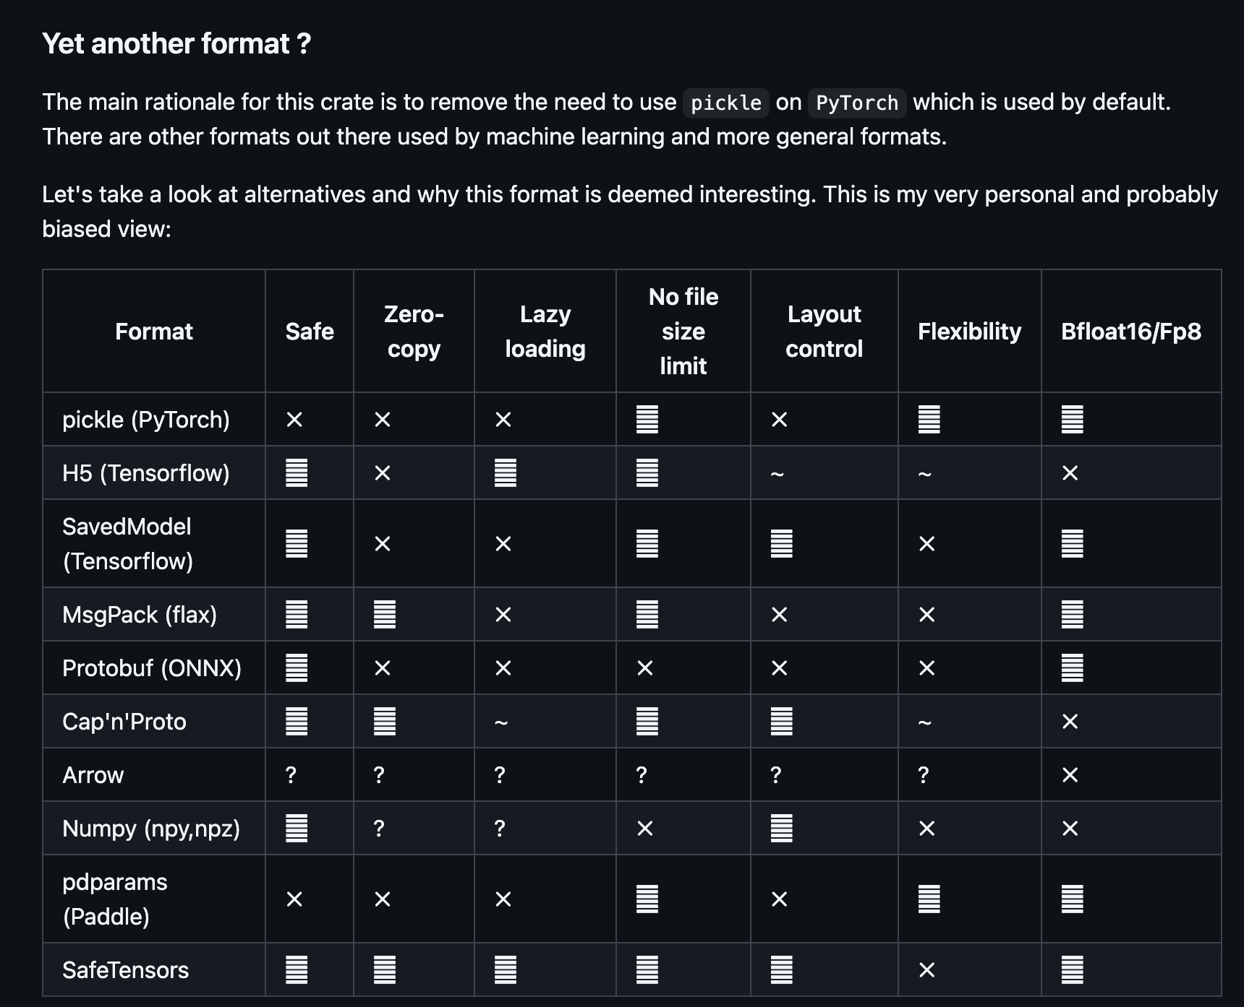
Other Model Formats - SafeTensors
  Created by HuggingFace and widely used.
  Externally audited, deemed safe.
  Ideally, you should use these.

Slide 19
Inference Servers

Slide 20
What is an inference server?
A frontend/API interface for models.
  Accepts inputs via REST/gRPC and passes these inputs to a backend.
Exposes APIs that allow for inference.
  e.g, lets people use the models.
  OpenAIs Chat Completions API is an example of an exposed inference API.
Exposes APIs that allow for model metadata, and management operations
Conceptually, similar to Apache Tomcat.

Slide 21
Why use an inference server?
Expensive to use cloud based AI providers.
As new models are released, value proposition for self-hosting gets better.
Many applications may need to use the same models.
Model weights are sensitive, ideal to not duplicate hosting them.
Complex workflows may require multiple models, concurrent processing or workflows. It is hard to implement this in-line within applications.
Applications may be written in a language that is different than the language the models have been trained on.

Slide 22
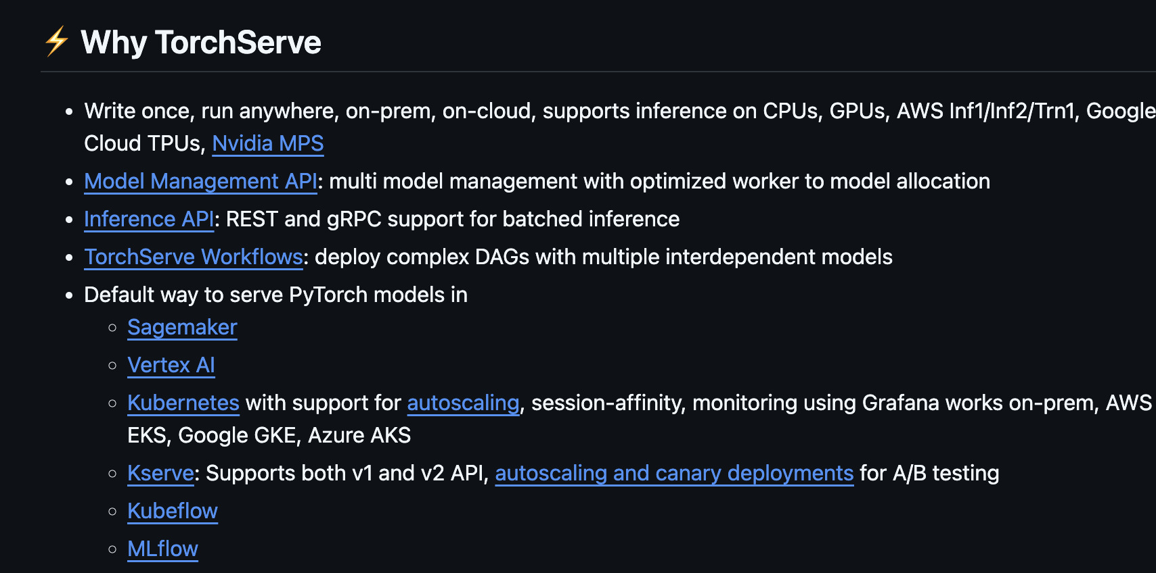
TorchServe
Model hosting component of PyTorch
  https://github.com/pytorch/serve/
  Maintained by AWS/ Meta
Supports LLMs
Component in popular services.
Uses a model archive format called MAR.

Slide 23
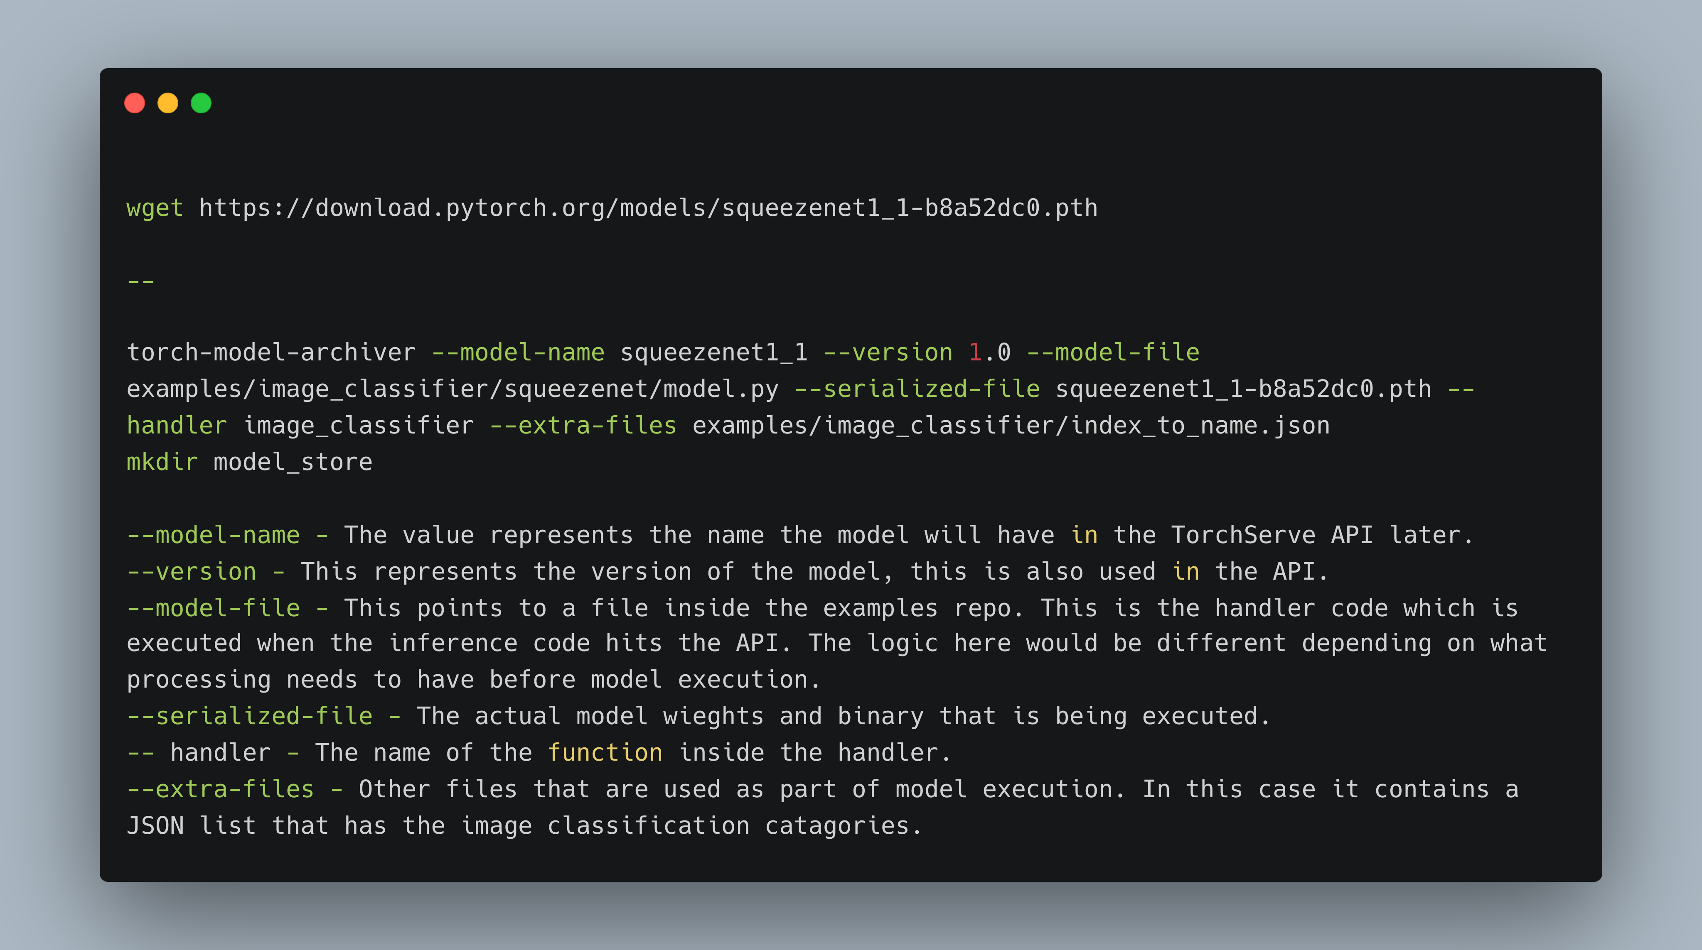

Slide 24
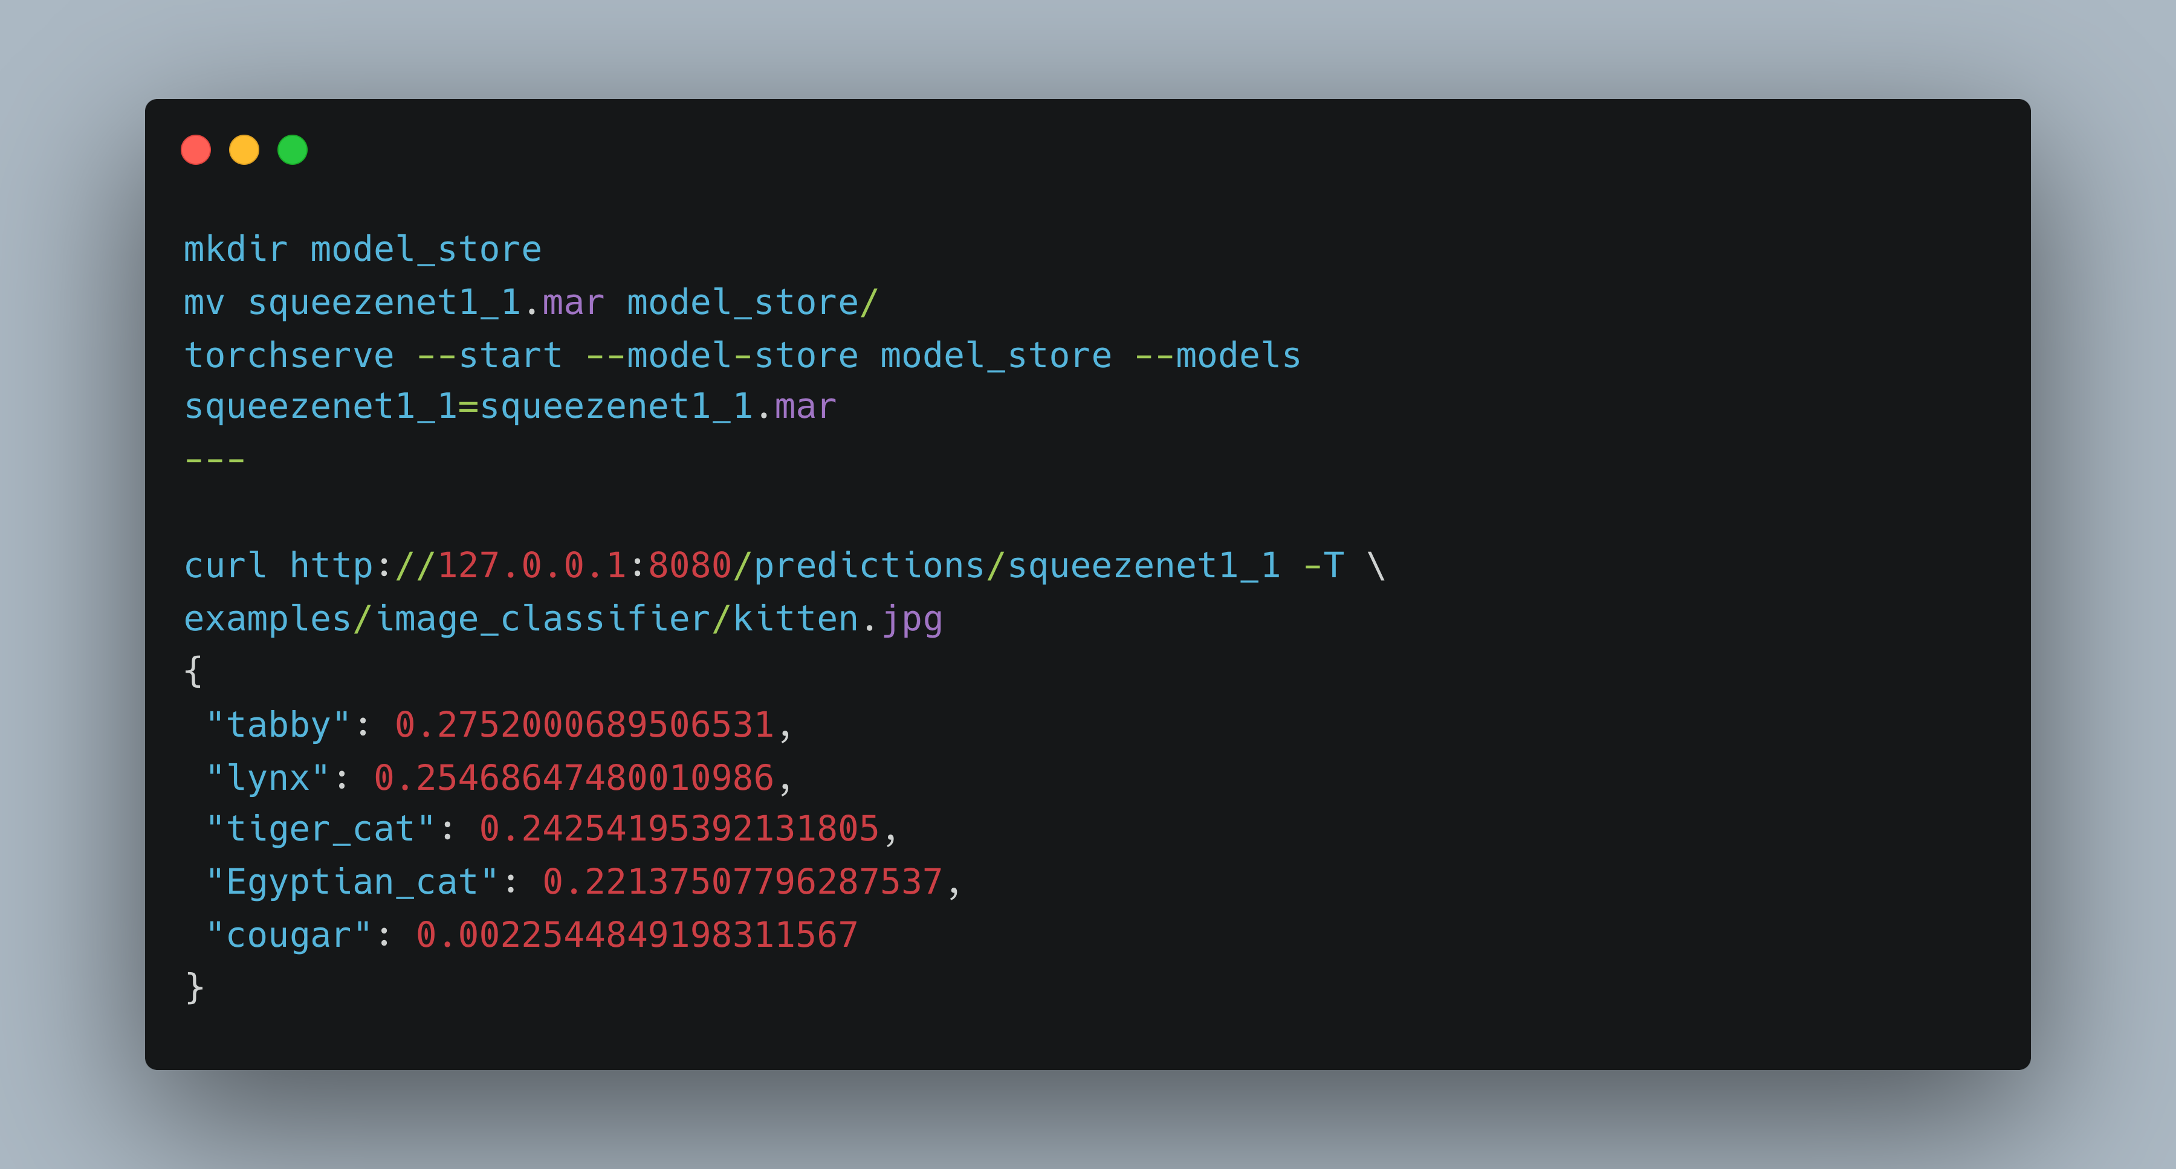

Slide 25
TorchServe – Security Concerns

Slide 26
Service Exposure
Services on launch:
  HTTP RESTFul Inference Server - 127.0.0.1:8080
  HTTP RESTFul Management API Server - 127.0.0.1:8081
  gRPC Inference server - 127.0.0.1:7071
  gRPC Management Server - 127.0.0.1:7072
  HTTP Metrics API Server - 127.0.0.1:8082
Earlier versions had these interfaces bound to 0.0.0.0
  In practice, you likely need to expose these APIs to use them.
Multiple versions of APIs can lead to inconsistent configurations, such as..

Slide 27
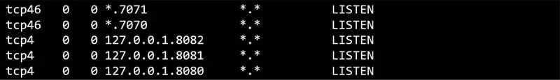
CVE-2024-35199 –gRPC Misconfiguration
gRPC interfaces were not bound to localhost, despite documentation saying otherwise.
Seems silly, but these APIs being exposed is quite impactful because…

Slide 28
Authentication – or a lack of it.
Prior to the latest version, TorchServe implemented no default authentication on any APIs.
  It is possible to perform inference on any model that is running.
  It is possible to arbitrarily load, unload models and perform other management actions
  TorchServe doesn’t support authentication natively. To avoid unauthorized access, TorchServe only allows localhost access by default. The inference API is listening on port 8080. The management API is listening on port 8081. Both expect HTTP requests. These are the default ports. See Enable SSL to configure HTTPS.

Slide 29
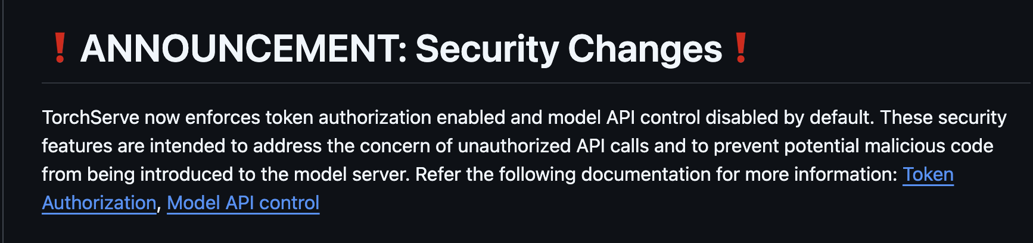
Authentication – and the presence of it.
The newest version of TorchServe has updated their authentication defaults:
  The team at AWS was super receptive to feedback and generally made many awesome security improvements.

Slide 30
Authentication – a common gap
Other inference servers have similar configurations
  TensorFlow Serving – binds to 0.0.0.0 – no default authentication
  Triton Inference Server – binds to 0.0.0.0 – no default authentication.
Developers have raised performance concerns with enforcing authentication.
This puts a massive amount of importance on restricting APIs via network controls – which is made harder by the amount of endpoints.

Slide 31
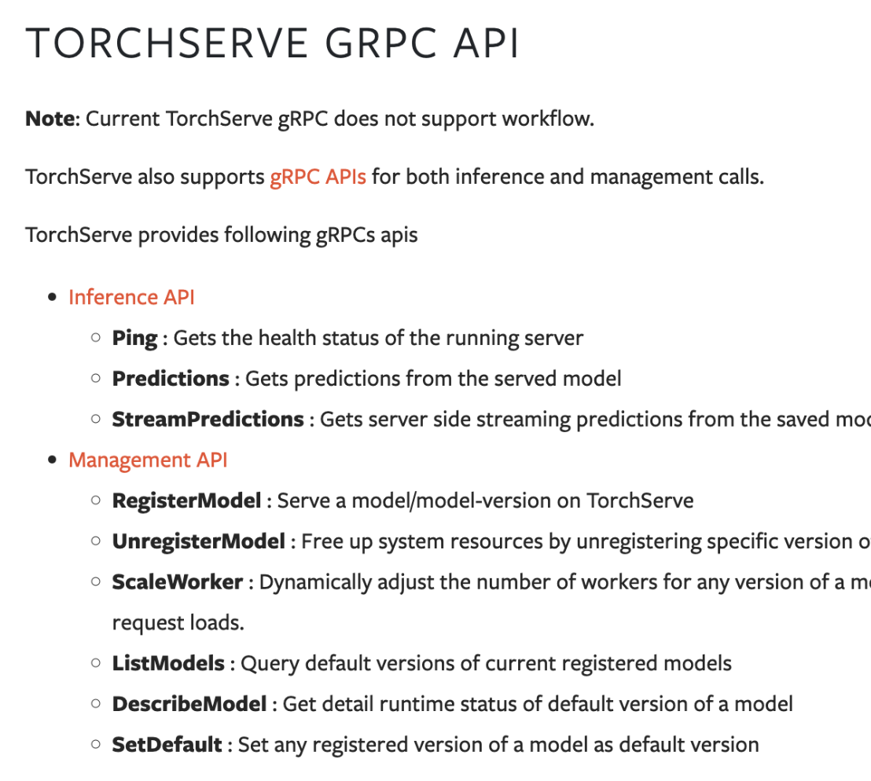
Code Execution - TorchServe
RegisterModel accepts a URL parameter. URL can point to:
  A local file path (file://)
  A arbitrary URL on the internet.
Target file needs to be a MAR file.
Target file is copied into model store folder and can be invoked.
This can trivially be abused for code execution.

Slide 32
Code Execution – Handler File
The –model-file parameter points to a python file.
Used to “handle” inference requests and prepare inputs.
Injected code executes when performing inference
torch-model-archiver --model-name squeezenet1_1 --version 1.0 --model-file examples/image_classifier/squeezenet/model.py --serialized-file squeezenet1_1-b8a52dc0.pth --handler image_classifier --extra-files examples/image_classifier/index_to_name.json

Slide 33
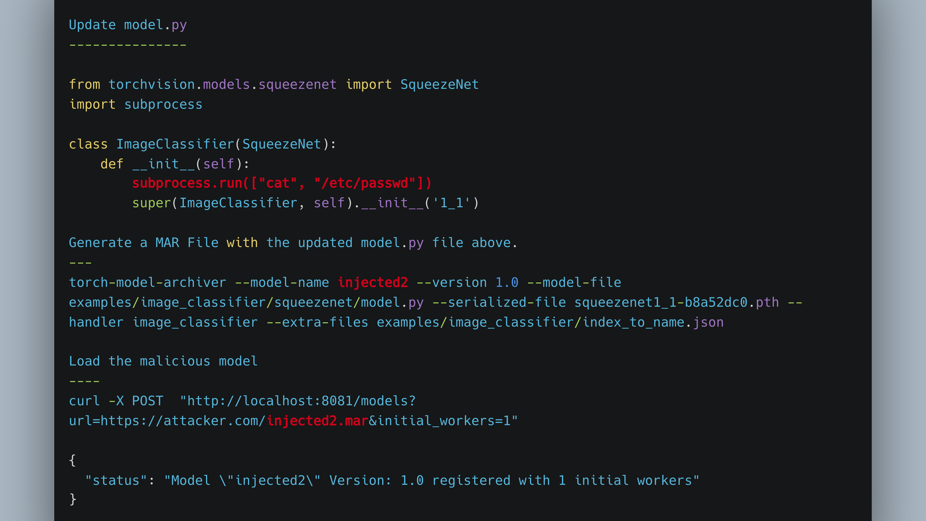

Slide 34
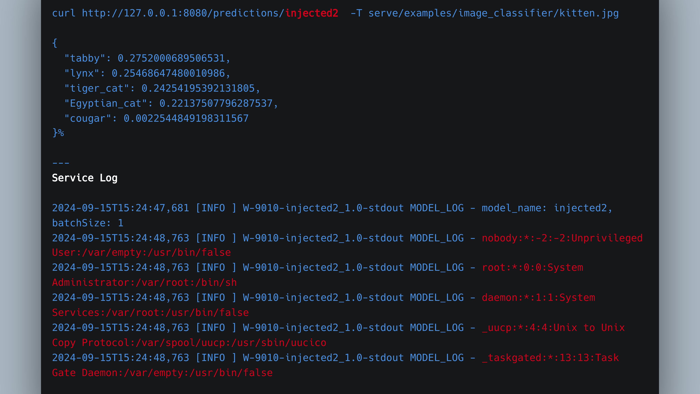

Slide 35
Code Execution – Serialized Model File
The --serialized-file points to a PyTorch model file.
Execution happens when model is loaded/registered
  Model is loaded via torch.load()
torch-model-archiver --model-name squeezenet1_1 --version 1.0 --model-file examples/image_classifier/squeezenet/model.py --serialized-file squeezenet1_1-b8a52dc0.pth --handler image_classifier --extra-files examples/image_classifier/index_to_name.json

Slide 36
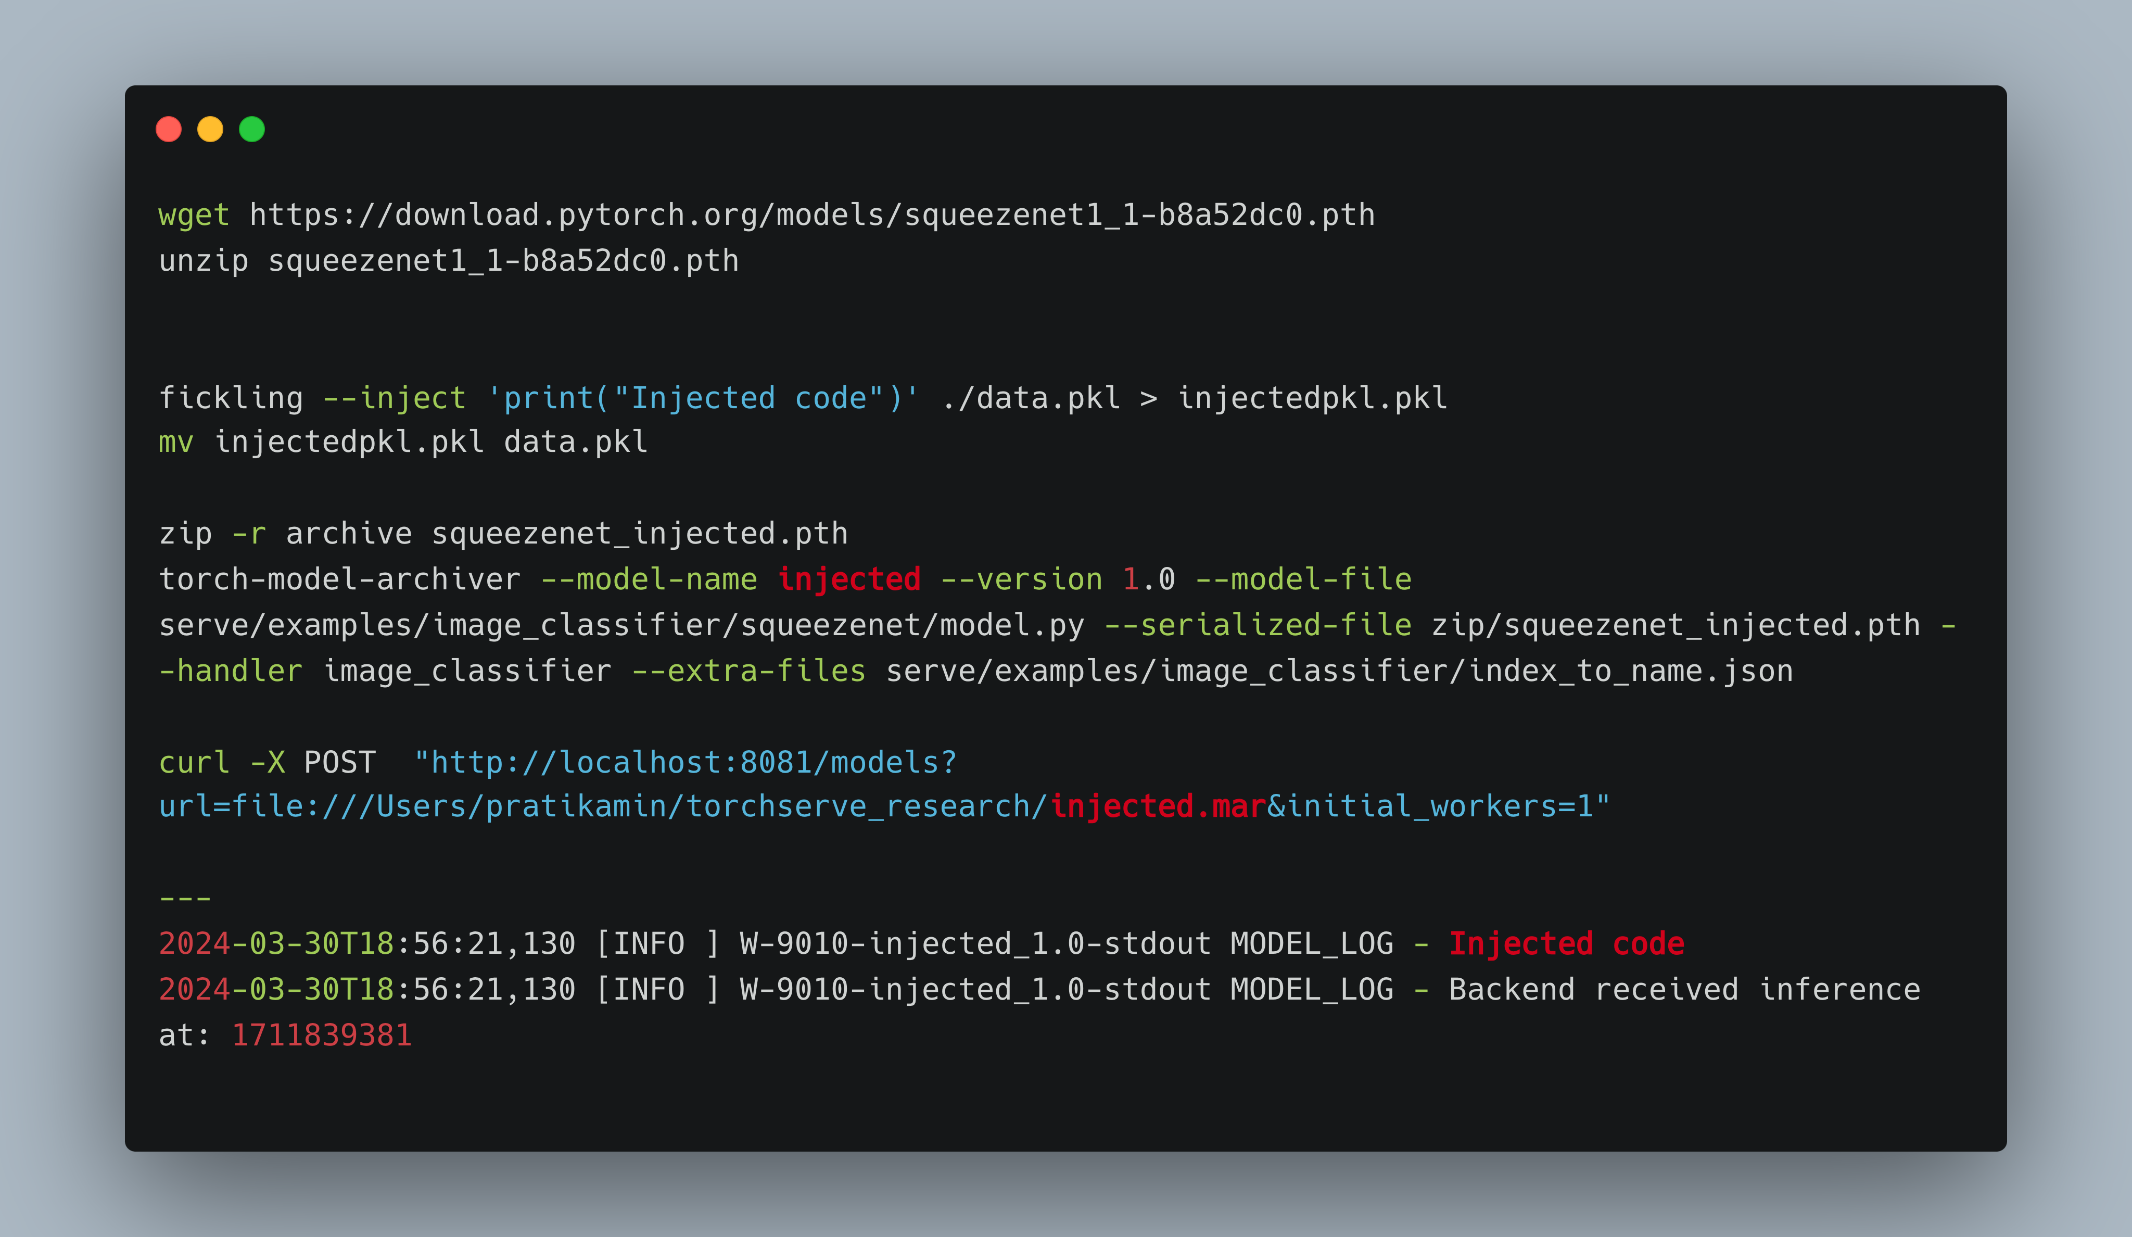

Slide 37
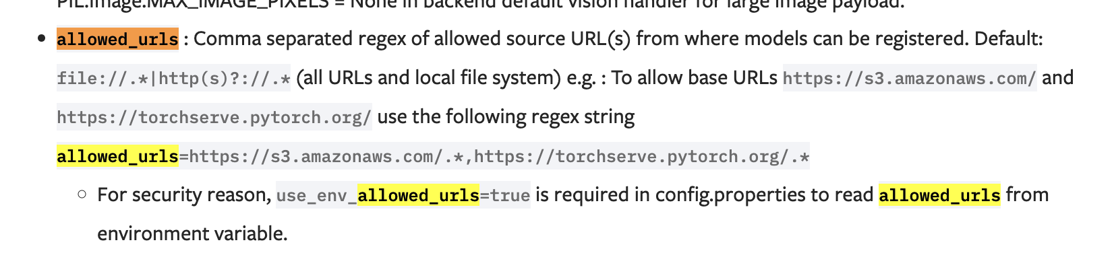
TorchServe – allowed_urls
TorchServe allows you to restrict access to specific https:// or file:// paths.
  Users must define allowed_urls at startup.

Slide 38
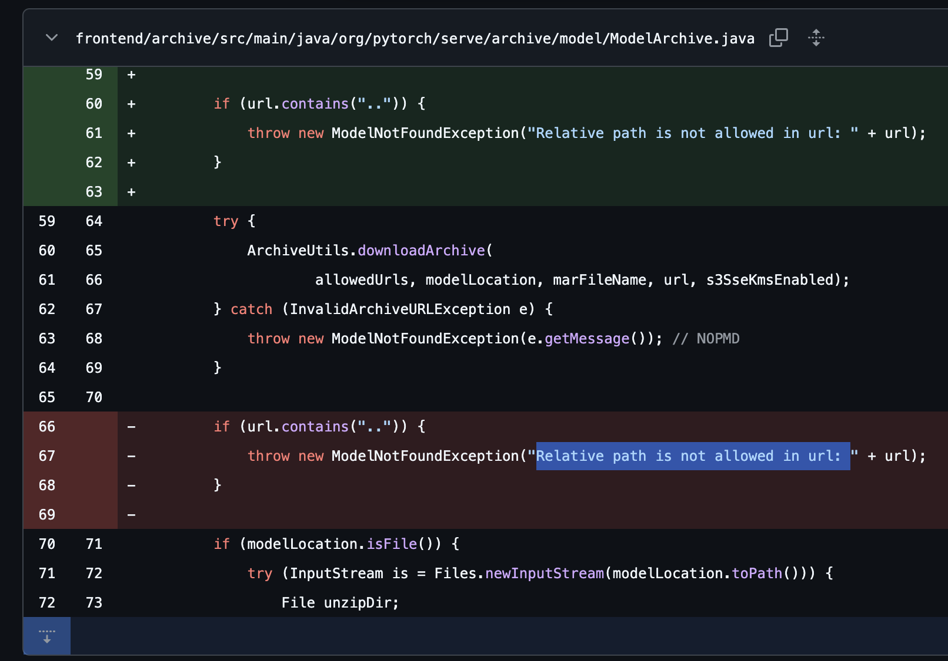
CVE-2024-35198 – allowed_urls Bypass
If url parameter contained a path traversal payload (”..”) TorchServe would return a validation error.
Payload downloaded before validation
Models inside of model store do not require any paths, thus bypassing this control.

Slide 39
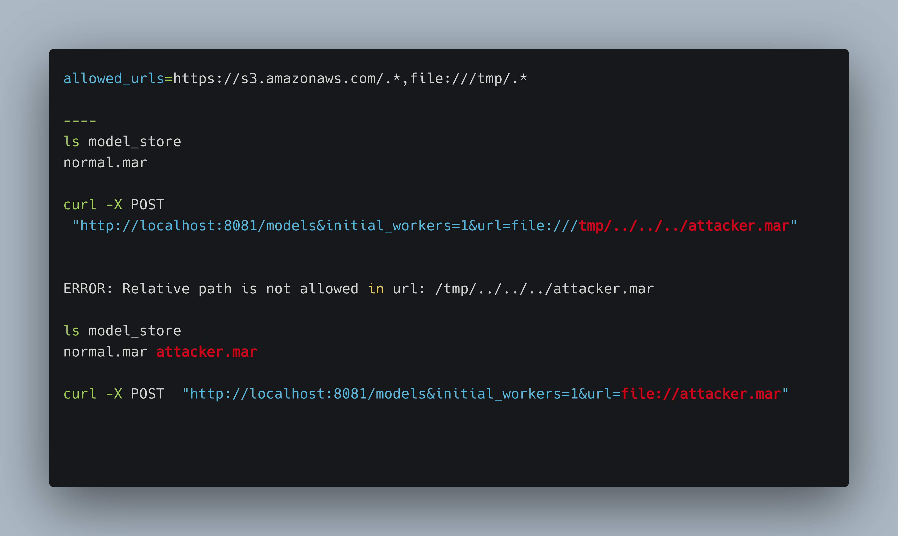

Slide 40
Other Inference Servers - Triton
Triton Inference Server is made by NVIDIA
  supports different backends (including vLLM)
Triton exposes both HTTP and gRPC APIs
  These APIs have no authentication by default and are bound to 0.0.0.0
Triton supports cloud-based model repositories (e.g. S3).
Model management APIs can be abused for code execution.

Slide 41
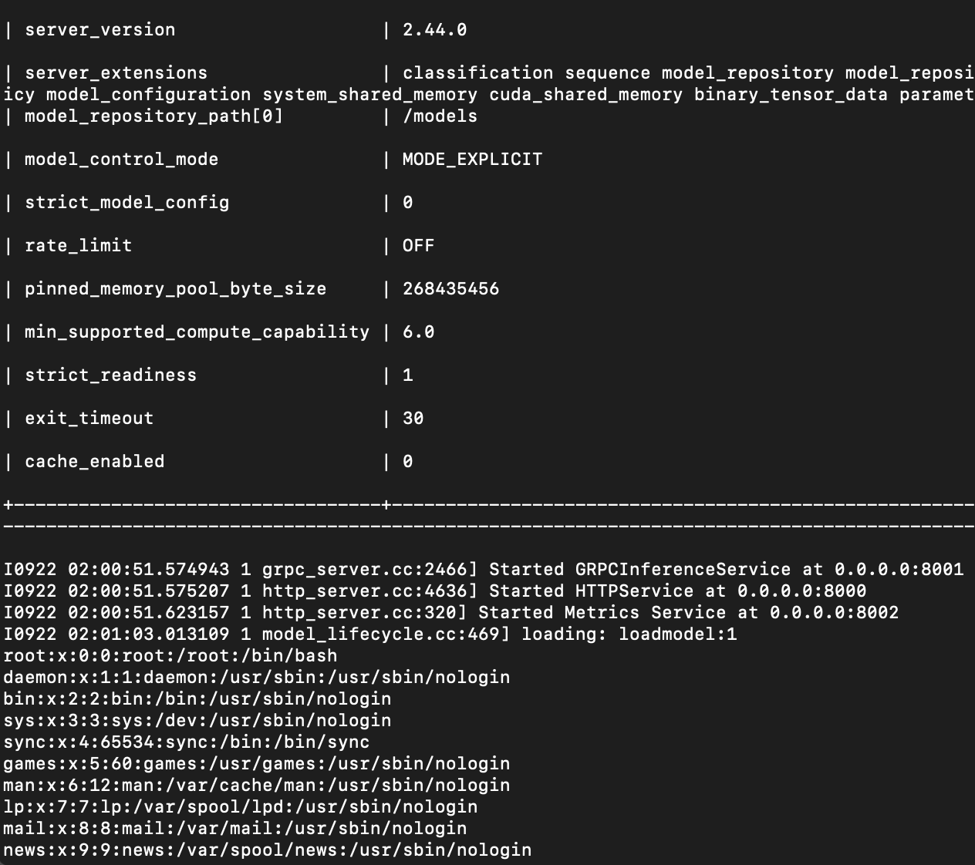
Triton – Model Management
Triton has three modes of model management control
  none – Default, prevents any new models from being loaded for any reason.
  poll – Polls model repo for new files
  explicit – Exposes the model load API at POST v2/repository/models/${MODEL_NAME}/load

Slide 42
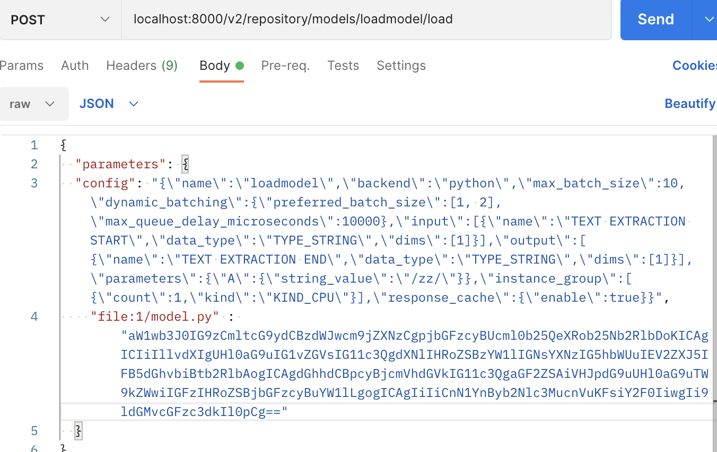
Triton – Explicit Mode
Requirements
backend – python
file:1/model.py
Base64 must contain a class named TritonPythonModel

Slide 43
Other Inference Servers – TensorFlow Serving
TensorFlow Serving is maintained by Google.
Serves a REST interface on 0.0.0.0:8051 with no authentication
Serves a gRPC interface on 0.0.0.0:8050 with no authentication
gRPC interface exposes tensorflow.serving.ModelService/HandleReloadConfigRequest
  This can be used to load models from arbitrary locations on disk.
  This overwrites running config, leading to DoS if input is invalid.
  Models need to be in TensorFlows SavedModel format

Slide 44
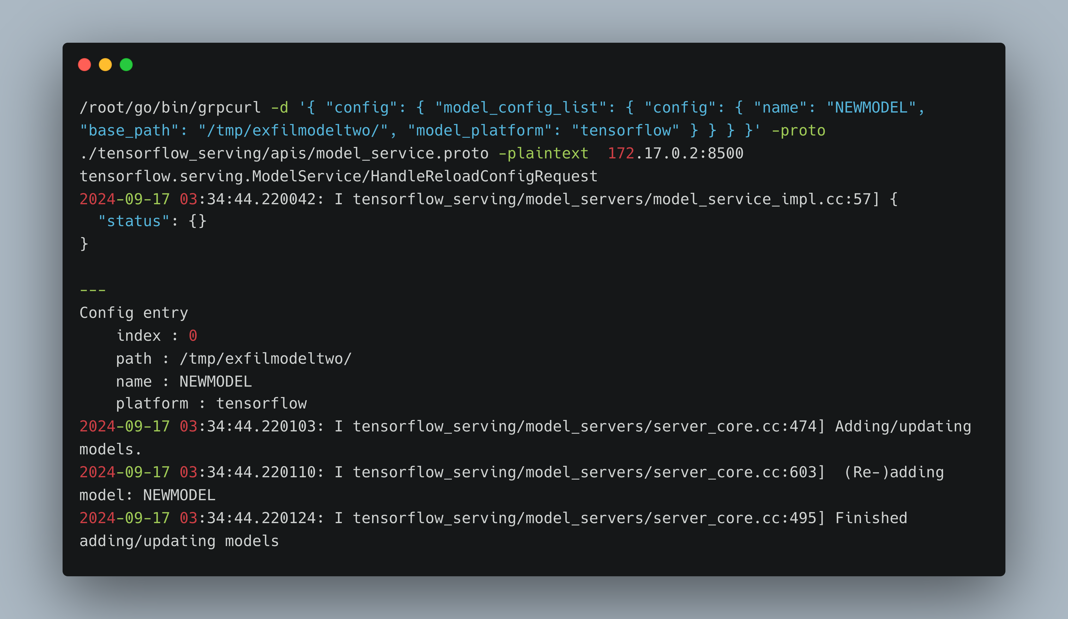

Slide 45
Conclusion
As a attacker:
  Look for places where models are loaded and managed.
  Being able to write to the filesystem/cloud location where models are stored can lead to code execution
  Look for torch.load() or similar functions in code review.
As a defender:
  Use safe model formats whenever possible.
  Be very aware network exposure of services.
  Enable optional authentication and disable unused features.
  Enumerate which users can push new models/write to filesystem
  Read the API documentation!

Slide 46
Thank you!

